Slide 1
WHO ARE WE
Address: 146, JLPL Industrial Area
Sector 82, Mohali, (1600550) Punjab, India
Website: www.eurotechworld.net
Notes:
Dear All,
Welcome to the Eurotech Assessment and Certification Services Private Limited.
We are based at 146, JLPL Industrial Area
Sector 82, Mohali, (160055) Punjab, India
We would like to introduce ourselves in the subsequent slides.
Let you know us that “ WHO WE ARE”

Slide 2
GROUP OF COMPANIES
Eurotech Assessment And Certification Services Pvt Ltd
Institute of Testing and Certification (ITC) India Pvt Ltd
Med Devices Life Sciences Private Limited
Standard Test Equipments (STE) India Pvt Ltd
Notes:
Eurotech Assessment and Certification Services Private Limited is one of the company of the Group of Companies.
Besides, Eurotech Assessment and Certification Services Private Limited
We have Institute of Testing and Certification (ITC) India Pvt Ltd
Med Devices Life Sciences Private Limited
Standard Test Equipment (STE) India Pvt Ltd

Slide 3
WHO WE ARE?
Eurotech Assessment And Certification Services Pvt. Ltd. was established in the year 2008 from Panchkula.
Our brief service entity includes CE Marking Certification Service, Electrical Testing Service, Welder Training Service, Social Audit Service and many more services in the list.
Our organization is highly recognized in the industry because of its incomparable qualities such as superior service quality, supportive team members and guidance of expert.
Notes:
Let us know our credentials, that who we are ?
Eurotech Assessment And Certification Services Pvt. Ltd. was established in the year 2008 from Panchkula.
Our brief service entity includes CE Marking Certification Service, Electrical Testing Service, Welder Training Service, Social Audit Service and many more services in the list.
Our organization is highly recognized in the industry because of its incomparable qualities such as superior service quality, supportive team members and guidance of expert.

Slide 4
OUR FOOTPRINTS
Mohali (Chandigarh)
Ghaziabad
Ahmedabad
Mumbai
Chennai
Coimbature
Tirupur
Lucknow
Haridwar
Dubai
UAE
Ireland
UK
Netherland
Greece
USA
Canada
Bangladesh
Notes:
Our footprints are spread nationally and internationally
We have presence in the following countries
Dubai
UAE
Ireland
UK
Netherland
Greece
USA
Canada
Bangladesh
We have presence in the following cities in India
Mohali (Chandigarh)
Ghaziabad
Ahmedabad
Mumbai
Chennai
Coimbature
Tirupur
Lucknow
Haridwar

Slide 5
WHY US?
We have acquired a paramount position in the industry with the immeasurable support of our work forces.
We have always advised our customers with a rich assortment of services and products with quality at par assured.
Our sheer methods of dealing, client eccentric approaches, ethical policies and a commitment to keep the quality maintained has made us foremost choice among our customers.
We have made indigenous efforts so as to last a longer relationship with our customers.

Slide 6
ALLIANCES:-
AWS CWI (USA)
API (USA)
EUROCERT (GREECE)
CQI IRCA (UK)
NBQP (INDIA)
NABL (INDIA)
ITC (INDIA)
DEDAL- Bulgaria for CE CPR Certification
Notes:
Eurotech has alliances across the globe with number of regulatory authorities which are
AWS CWI (USA)
API (USA)
EUROCERT (GREECE)
CQI IRCA (UK)
NBQP (INDIA)
NABL (INDIA)
ITC (INDIA)
DEDAL- Bulgaria for CE CPR Certification

Slide 7
OUR ALLIANCES
Notes:
Eurotech has alliances of regulatory authorities shown with logos

Slide 8
WHAT WE DO..
ISO 9606,15614,14731,14732 & 3834 (WELDER TRAINING)
ISO 9001:2015 FOUNDATION, INTERNAL AUDITOR AND LEAD AUDITOR TRAINING
ISO 13485:2016 MED TRAINING
PHOTOMETRY TRAINING
ISO 17025:2017 – TESTING AND CALIBRATION LABS
AWS-CWI , AWS-CWSR TRAINING
BASIC AND ADVANCE WELDER TRAINING AND CERTIFICATION
NDT AND DT TRAINING AND CERTIFICATION
API Q1 TRAINING
SA 8000 TRAINING
PROBLEM SOLVING TRAINING
ISO 27001 TRAINING
RISK MANAGEMENT TRAINING
Notes:
WHAT WE DO actually, We do certification and training in
ISO 9606,15614,14731,14732 & 3834 (WELDER TRAINING)
ISO 9001:2015 FOUNDATION, INTERNAL AUDITOR AND LEAD AUDITOR TRAINING
ISO 13485:2016 MED TRAINING
PHOTOMETRY TRAINING
ISO 17025:2017 – TESTING AND CALIBRATION LABS
AWS-CWI , AWS-CWSR TRAINING
BASIC AND ADVANCE WELDER TRAINING AND CERTIFICATION
NDT AND DT TRAINING AND CERTIFICATION
API Q1 TRAINING
SA 8000 TRAINING
PROBLEM SOLVING TRAINING
ISO 27001 TRAINING
RISK MANAGEMENT TRAINING

Slide 9
ISO 9001:2015 TRAINING
ISO 9001 Training Foundation
ISO 9001 Internal Auditor Training
ISO 9001 Internal Auditor Training
ISO 9001 Internal Auditor Workshop
Notes:
UNDER ISO 9001:2015 TRAINING, WE CONDUCT
Foundation Training
Internal Auditor Training and Workshop
Lead Auditor Training

Slide 10
API Q1 TRAINING
API Q1 Training- API-U 9th Fundamental Edition Course
API Q1 Training- API-U 9th Practitioner Edition Course
Notes:
Eurotech is one of the rarest member for internationally for API training for
API Q1 Training- API-U 9th Fundamental Edition Course
API Q1 Training- API-U 9th Practitioner Edition Course

Slide 11
AWS CWI TRAINING
AWS-American Welding Society
AWS-CWI Certified Welding Inspector Training Course
AWS-CAWI Certified Associate Welding Inspector Training
AWS-SCWI Senior Certified Welding Inspector Training
AWS-CWE Certified Welding Engineer Training
AWS-CWS Certified Welding Supervisor Training Course

Slide 12
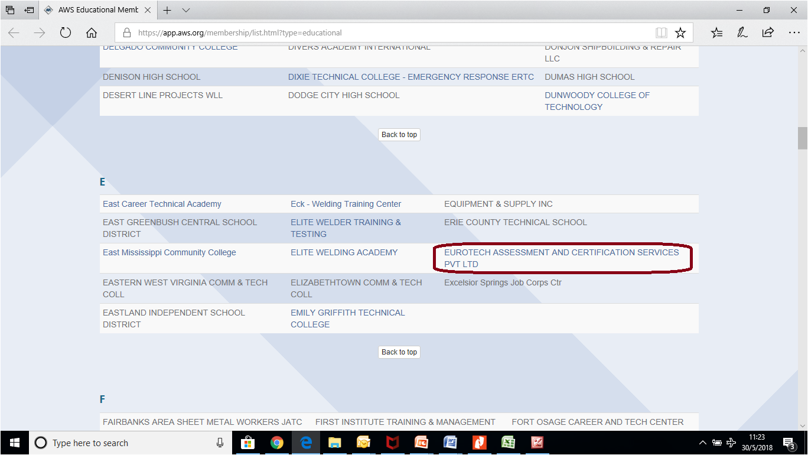
WELDER TRAININGS
American Welding Society (AWS) Certified Welding Inspector (CWI)
American Welding Society (AWS) Certified Welding Sales Representative (CWSR)
QA/QC Welding Inspector Training
NDT/DT Training
Supervisors/Coordinator Training
Composite Welding Training
Welding Qualification Certification
Approval Testing Welding Operators
Customized Training
Notes:
Eurotech is conducting welding training in India and abroad in the number of courses which are
American Welding Society (AWS) Certified Welding Inspector (CWI)
American Welding Society (AWS) Certified Welding Sales Representative (CWSR)
QA/QC Welding Inspector Training
NDT/DT Training
Supervisors/Coordinator Training
Composite Welding Training
Welding Qualification Certification
Approval Testing Welding Operators
Customized Training

Slide 13
ISO 27001 LEAD AUDITOR COURSE INFORMATION SECURITY
Notes:
Eurotech is conducting training in the ISO 27001 Lead Auditor Course Information Security regularly.

Slide 14
PROBLEM SOLVING TRAINING
Notes:
Eurotech is conducting regular training in the Problem Solving Training

Slide 15
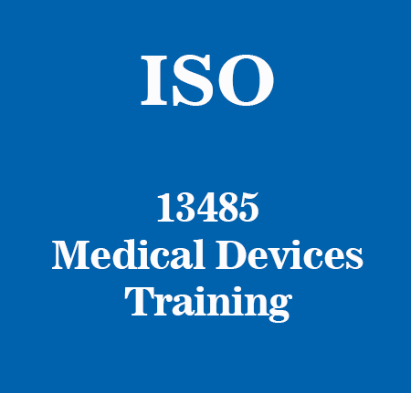
ISO 13485:2016 FOUNDATION COURSE
Notes:
Eurotech is conducting regular training in the ISO 13485:2016 Foundation for the medical devices

Slide 16
SA 8000 FOUNDATION CUM INTERNAL AUDITOR COURSE (DATA QUALITY)
Notes:
Eurotech is conducting regular training in the SA 8000 Foundation Cum Internal Auditor Course (Data Quality)

Slide 17
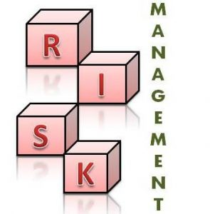
RISK MANAGEMENT TRAINING ISO 31000: 2008
Notes:
Eurotech is conducting regular training in the ISO 31000: 2008
Risk Management Training

Slide 18
PHOTOMETRY TRAINING
Notes:
Eurotech is conducting regular training in the Photometry Training.
Eurotech has the NABL approved lab for the photometry devices testing

Slide 19
ISO 17025:2017 INTERNAL AUDITOR COURSE
Notes:
Eurotech is conducting regular training in the Latest ISO 17025:2017 Internal Auditor Course (LMS)
Eurotech has the NABL approved testing lab with large number of scopes.
ISO 17025:2017 Internal Auditor Course is approved by NBQP and is listed on their portal.

Slide 20
Contact Us For any query/ vendor registrations/ Bulk-registrations/ International Tie-ups n.khatri@eurotechworld.net ; +91-9871231133 c.khatri@eurotechworld.net ; +91-9723766248 accre@eurotechworld.net ; +91-9872412545 Website: www.eurotechworld.net/trainings https://training.eurotechworld.net/
Notes:
Plase be free to contact us
For any query/ vendor registrations/ Bulk-registrations/ International Tie-ups
On the given email id and phone numbers. n.khatri@eurotechworld.net ; +91-9871231133 c.khatri@eurotechworld.net ; +91-9723766248 accre@eurotechworld.net ; +91-9872412545 Website: www.eurotechworld.net/trainings
https://training.eurotechworld.net/

